Slide 1

CEO Report
Exchange Board Meeting
March 27, 2025
Ingrid Ulrey, she/her
Chief Executive Officer
Ingrid.Ulrey@wahbexchange.org
206-330-6531
Notes:
Thank you Chair McLemore
For my report today – I am going to briefly summarize major developments for the Exchange that have occurred since we last met.
And then share an progres update on strategic priorities project over the past year, which was one element that the Exec committee of the board asked me to prepare for the CEO evaluation.
Focus this month – supporting staff and partners amidst uncertainty – reminding people that there is hope – we can do hard things and we will get through this.
Calm
Steady
Focused
Flexible
Nimble

Slide 2
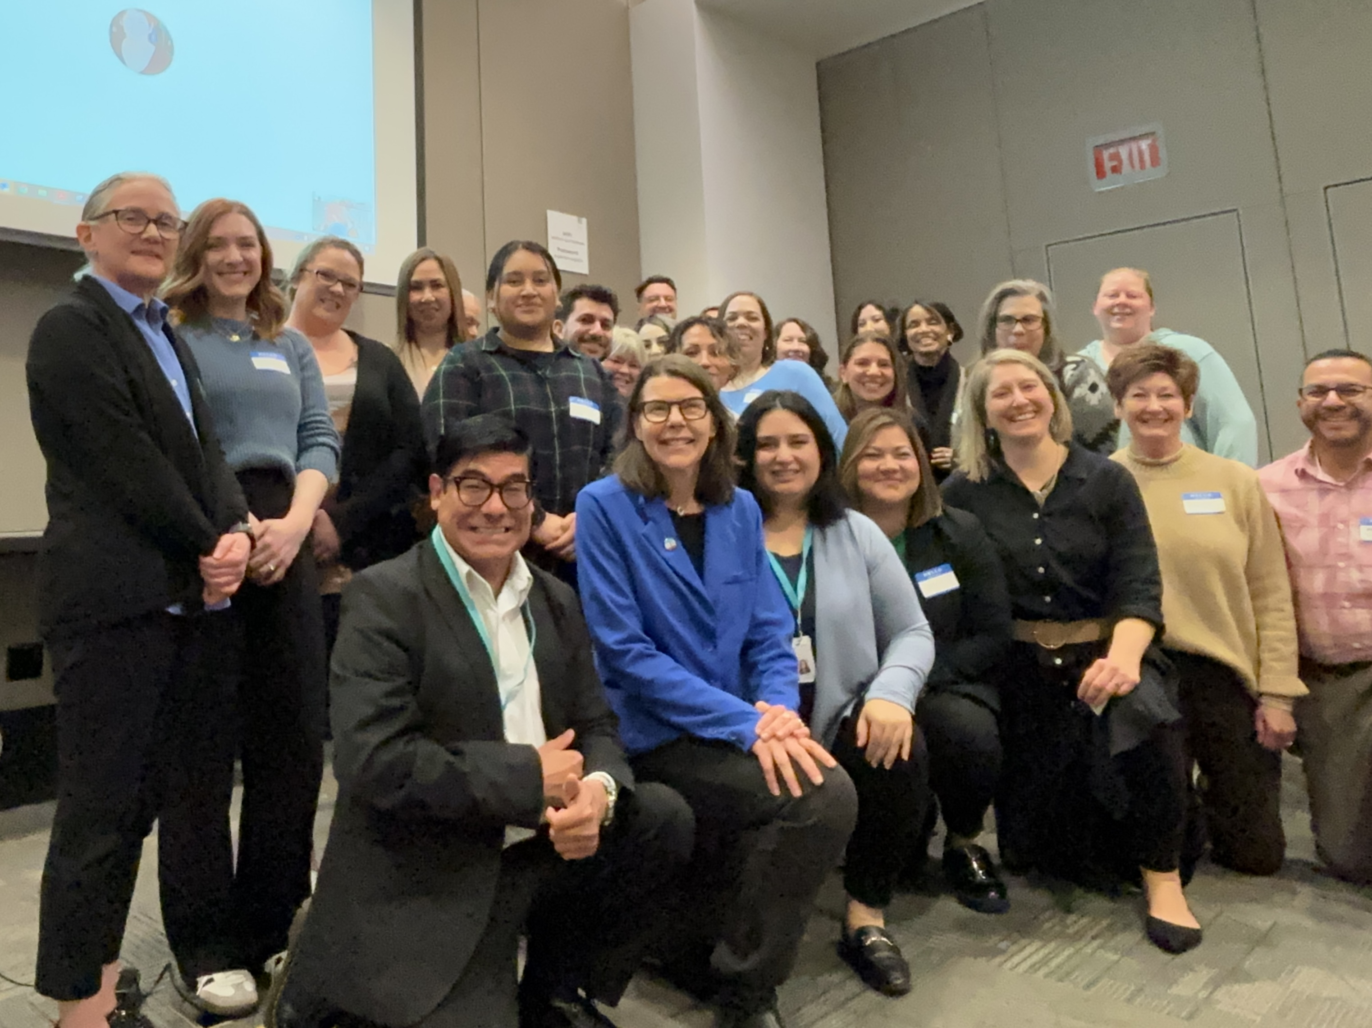

Key Developments
Federal
  Proposed Medicaid cuts
  CMS proposed Marketplace rule
State
  House and Senate released their budgets
  Commissioner Kuderer issued an emergency rule
Exchange
  Completed a major IT Modernization project milestone
  Convened Lead Organizations from across the state
Notes:
A lot has happened since we met at the State Capitol in February.
FEDERAL LEVEL
House and Senate Passed Budget Resolution – Framework includes $880 billion cut to the Medicaid program and X billion to the Marketplace to fund tax cuts.
You will hear more from HCA later this morning.
CMS Program Integrity and Affordability Rule –
measure intended to reduce unauthorized enrollments will result in significant reductions in authorized enrollments, which will come on top of major drops in enrollment if Congress allows the enhanced premium tax credits to expire.
You will hear more about this from Leah later this morning.
STATE
State House and Senate released budgets -
You will hear more about this Jim and Shirley
Overall – we are relieved – in a touch budget environment, both budgets include our number one priority, CCS at least for one year – 2026, as well as most of the operating budget DP requests.
I had a chance to thank key budget writers - Sen June Robinson, Rep Nicole Macri - and we will continue to watch and engage in the process form here.
Insurance Commissioner Kuderer released an Emergency rule to address the affordability crisis – Standardized Silver Loading - $110 million fed funds impact, big thank you to her – Jane - and you will hear more from Leah.
EXCHANGE
Exchange completed a major IT Modernization project milestone – data base migration - moving 10 billion tows of data – HPF memory to the cloud
You will hear more about this later from April in the Operations report.
And I want to call out a huge thank you and appreciation for David Sorrell our CIO and his team and our partners at Deloitte who orchestrated this massive effort.
And finally, Exchange convened our Lead Organizations from across theses state – first time in person since COVID.
Leaders from Spokane, Yakima, Wenatchee and across the Puget Sound gathering here in this room to celebrate their collective impact during OE – navigators supported nearly percent of customers across 17
Huge thank you to Manny Santiago and his team for leading this work.

Slide 3
Strategic Priorities Progress – Biennial Plan, FY 2023-2025
Stabilize the Foundation
Position for the Future
Secure & Modernize the Platform
Improve Customer Experience
Advance Health Equity
Notes:
Strategic Priorities Progress Report
Time frame - March 2024 – March 2025*
This slide illustrated the 5 strategic priorities established by the leadership team for the FY 2023 – 2025 Biennial plan.
These priorities are rooted in the Exchange mission and strategic direction from the board.
The priority areas provide the framework for the biennial plan.
* Some of the progress reported in the following slides may fall outside this exact time frame, but are generally in the 2024 calendar year period.

Slide 4
People
Recruited and onboarded new leaders
Strengthened key departments
Supported ELT team development
Launched Equity and Belonging Strategic Plan
Stabilize the Foundation
Progress Update
Stronger people & teams
Matured tools and capabilities
Reduced liability and risk
Tools and Capabilities
Established Portfolio Team / adopted Smart Sheet
Reassessed Adobe Experience Manager
Re-procured consumer decision support system
Pivoted to functionally aligned scrum teams
Liability and Risk
Resolved font license issue / broker dispute
Tightened records retention compliance
Automated manual processes
Resumed auto check to ensure accurate enrollment
Notes:
Details and examples – progress against the plan:
Stronger People & Teams
Recruited / onboarded new leaders - New Govt Affairs Director, DEI Manager, Compliance Officer, Senior People and Culture Team leader
Strengthened Key Departments – adjusted structure, improved management capability and role definition for assistant directors (ECP, Comms, Policy plus improvement in Exec – PPM team)
ELT Team Development – 2-day summer retreat led by Clarity Consultant resulted in measurable improvement in team function (staying at the strategic level) and dynamics (leading with candor)
Launched Equity and Belonging Plan – This 5-year plan highlights gaps and established goals, accountability measures and pathways for continuous improvement.
Matured Tools and Capabilities
Established the Portfolio Team - composed of mid-level managers who serve as liaisons between their department and the biennial plan, track cross functional impacts across all major initiatives, prioritize work flows and escalating capacity collisions to ELT.
Adopted Smart Sheet – a cloud-based project management tool to plan, track and manage boulders (major cross functional initiatives in the five strategic priority areas) across departments and over time.
Reassessed Adobe Experience Manager – To increase innovation and reduce costs, both communications and IT worked closely with Adobe to ensure that we are currently receiving the maximum benefits and increasing their accountability to the contract.
Re-procured the Customer Decision Support Solution – completed procurement for vendor to manage the Smartplanfinder function in HPF, an option for consumers to see display of top 3 plans that would best fit their health and budget needs
Pivoted to functionally aligned scrum teams – Restructured scum to enable ownership of specific functions within HPF from start to finish.
Reduced Liability and Risk
Reduced organizational liability – remediated font licensure issue and removed font in question from HPF and corporate sites, resolved broker dispute regarding transferred accounts.
Tightened records retention – enterprise wide “Spring Cleaning Initiative” completed to clean up shared drives, remove duplicate files and inventory retained records.
Automated manual processes – numerous system improvements including automating customer support for individuals who are denied federal premium assistance because they did not file their taxes, a change that improved customer ability to easily self-serve and is significantly reducing workload for our eligibility team.
Strengthened program integrity – This involved a refresh of the data integrity checker and a focused initiative to increase timely and accurate enrollment and eligibility, we resumed failure to reconcile checks (amount APTC matches income) and periodic data matching (removing those who have died or moved to Medicare).

Slide 5
System Stability
Completed ongoing maintenance and operations
System readiness for OE12
Achieved system stability and limited outages
Supported record high customer traffic
Secure & Modernize the Platform
Progress Update
Ensured system stability for OE12
Modernized our IT ecosystem
Increased security safeguards
Modernization
Revised strategy and roadmap
Migrated to new cloud environment
Moved from Oracle to Microsoft Azure data base
Rolled out initial Artificial Intelligence capabilities
Security
New tools for vulnerability identification
New systems for 24/7 logging and monitoring
New capabilities to safeguard critical data
Tri-annual IRS audit with no critical findings
Notes:
Details and examples - progress against the plan:
Prepared system for OE 12 - Our team completed regular maintenance and operations to ensure we “kept the lights on” and smoothly handled higher than ever OE customer traffic on Healthplanfinder and through associated modules.
Modernization – revised modernization strategy and roadmap
Revised the IT modernization strategy and roadmap
Established a new cloud environment and migrating applications from on-premises and existing cloud environments to this new environment with a target completion of 2026
Transitioning from Oracle to Microsoft Azure SQL database with goal to complete transition in March 2025
Established AI governance model and strategy and rolled out initial AI capabilities (Microsoft Co-Pilot, GitHub Co-Pilot)
IT Security – increased security safeguards
Implemented tool for better vulnerability identification in our cloud-based computing environment
Deployed new system logging and monitoring tool to provide improved visibility into security incidents
Established partnerships with external service providers for continuous monitoring and response to security threats
Deployed new capabilities to safeguard critical data
Published internal cyber incident playbook
Successfully completed tri-annual IRS audit with no critical findings
Fostered a culture of security through awareness training and regular newsletter posts

Slide 6
Immigrant Health Coverage expansions
Enrolled 2,000 in Qualified Health Expansion
Enrolled 12,000 in Apple Health Expansion
Enabled DACA population access to federal subsidies
Direct grants to CBOs enabled tailored outreach
Advance Health Equity
Progress Update
Immigrant health coverage expanded
Affordability improved through Cascade Care tools
Trust built through greater investment in community partnerships
Affordability Gains
Public option available statewide first time ever
79 percent of customers chose a standard plan
115,000 benefited from Cascade Care Savings (CCS)
41 percent of customers paid $100 or less per month
Community Partnerships
More active engagement with lead organizations
Deepened tribal engagement
Revitalized Health Equity technical advisory group
Grew and improved language access
Notes:
Details and examples - Progress against the plan:
Advance Health Equity
1.Expanded immigrant health coverage
Enrolled 2000 in Qualified Health Expansion – system changes, tailored marketing, extensive call center and in person assistor training.
Enrolled 12,000 in Apple Health Expansion – extensive coordination with DSHS, HCA, additional training for outreach teams.
Enabled DACA population access to federal subsidies – system change and training.
Direct grants to CBOs enabled tailored outreach – up to 20k each for 11 organizations representing populations with highest rate of uninsurance.
2. Improved affordability through Cascade Care tools
Public option available statewide first time ever – continued work with carriers and providers.
79 percent of customers chose a standard plan – evidence of customer demand for care before and lower deductibles, and ease or shopping experience.
115,000 benefited from Cascade Care Savings (CCS) – biggest impact for people of color and rural communities
41 percent of customers paid $100 or less per month – combination of federal and state subsidies
3- Community Partnership
More active engagement with lead organizations – more intentional relationship building and increased convening across staff and leadership.
Deeper tribal engagement - new Tribal Liaison who significantly increased tribal engagement through our Tribal Advisory Workgroup, and Tribal assistor meetings, Dear Tribal leaders, visits with tribal leaders in community and in highest level and most important events such as Governor’s Indian Health Advisory Committee and the Centennial Accord.
Revitalized Health Equity technical advisory group – Chief of Equity and Community Partnerships Manny Santiago recruited new members to this group and established a more interactive format for the meetings, focused on listening.
Grew language access program - created a new translation process including a bank of common terms so that all translators are utilizing the language in the same way. Helps our customers get consistent, medically appropriate information and accurate information.

Slide 7
Healthplanfinder Portal
Modernized HPF front door
Created language specific landing pages
Improved accessibility assessment design
Reduced outages and downtime
Improve Customer Experience
Progress Update
HPF portal customer interface improved
High service levels at the customer support center sustained
Outreach and support to in-person assistors increased
Customer Support Center
Supported record high call volumes
Sustained rapid speed of answer
Responded to more than 1,000 chats per day
Provided equity training for representatives
In-Person Assistance
Established a tribal lead organization (AIHC)
Revitalized the broker technical advisory committee
Completed outreach to Boeing workers on strike
Rapid response to 3,000 experiencing job loss
Notes:
Details – Progress against the plan
HPF portal customer interface improvements –
Modernized HPF front door - to make sure most relevant information was prominent, made the path to getting services clearer and took out unnecessary of complicated language while updating and modernizing the visuals to look more modern and professional.
Created language specific landing pages on HPF – which allow for a more seamless experience from an online search in a language or an advertisement in something like Seattle Chinese News. Customers click through and remain in their language with basic information and to get coverage.
Accessibility - expanded accessibility assessment and design review - including review of HPF correspondences and emails, as well as HPF account worker screens, the mobile app and other customer facing materials (such as what goes out to community partnerships).
Fewer outages and less down time - in 2024 compared to 2023 and 2022.
Customer Support Center
Support record high call volumes – peak volumes were over 90,000 calls per month during open enrollment.
Achieved rapid average speed of answer – average time across all months 1 minute and 25 seconds
Handled average of 1,230 chats per day
Equity training – provided equity training to customer support center representatives
In-person assistance
Established a tribal lead organization (AIHC)
Revitalized the broker technical advisory committee
Completed outreach to Boeing workers on strike
Rapid response to 3,000 experiencing job loss

Slide 8
Front Door for Health Coverage
Engaged with HHS IT coalition
Contributed to Integrated Eligibility Roadmap
Participated in CMS Rules inter-agency workgroup
Requested to support eligibility for Non-MAGI
Position for the Future
Progress Update
HPF positioned as the front door for health coverage for the future
Strategies implemented to mitigate future federal policy changes
Reintroduced the Exchange to the new state authorizing environment
Federal mitigation strategies
Standardized silver loading rule issued
Low gold standard plan approved
Cascade Care program modified
1332 waiver contingency planned
State Re-Introduction of the Exchange
Interim and post-election meetings
Exchange 101 presentations to HC committees
Biennial budget request and CCS priority ask
Engagement in Governor’s HHS Sub-Cabinet
Notes:
Details – Progress against the plan
1.Positioned HPF as front door for health coverage for the future
HHS IT Coalition – Engaged with State Agency Partners to develop the IEE Roadmap, portal Roadmap, CEO served on G1 governance committee, COO and CIO served on G2, extensive engagement with focus on stabilizing ACES complex, maintaining HPF front door and integrating across systems.
CMS Rules Cross Inter-agency workgroup - joined HCA/DSHS to plan for compliance, CEO serving on steering committee.
Responded to Request from HCA / OFM for ROM for supporting Non-MAGI eligibility
Completed Interim Report on Feasibility of Facilitated Enrollment - Policy team led
2.Implemented strategies to mitigate future federal policy changes
Standardized silver loading emergency rule issued
Low-Gold Standard Plan approved
Cascade Care Savings program modified
1332 waiver contingencies planned
3- Introduced the Exchange to the new state authorizing environment.
Interim and post-election meetings with new leaders
Exchange overview presentations for HC committees
Board Hill Day engagement with new leaders
Participation in Governor’s HHS Sub-cabinet

Slide 9
DRAFT Strategic Priorities for the FY 2025-27 Biennium
MISSION
Build Organizational Resilience
Position for the Future
Secure & Modernize the Platform
Keep People Covered
Improve Customer Experience
EQUITY
Notes:
Strategic Priorities Progress Report
Time frame - March 2024 – March 2025*
This slide illustrated the 5 strategic priorities established by the leadership team for the FY 2023 – 2025 Biennial plan.
These priorities are rooted in the Exchange mission and strategic direction from the board.
The priority areas provide the framework for the biennial plan.

Slide 10
Agenda
TIME | TOPIC
8:30 | Welcome and Roll Call
8:45 | Approval of Meeting Minutes
8:50 | CEO Report
9:05 | Policy Committee Report
9:15 | Operations Committee Report
9:25 | Legislative Session Update
9:45 | 2026 Carrier Assessment (BOARD ACTION)
10:10 | Public Comment
10:15 | Break – 10 min
10:25 | Medicaid Update & Q/A
10:40 | Federal Responsiveness Planning
11:20 | Executive Session of the Executive Committee
12:25 | Executive Committee Report-Out (Potential BOARD ACTION)
12:35 | Closing Remarks & Adjourn

Slide 11
Inaccurate > Strategic Priorities for the FY 2025-27 Biennium
MISSION
Build Organizational Strength
Adapt to a New Environment
Measure the IT Ecosystem
Keep People Covered
Protect Equity Gains
EQUITY
Notes:
Strategic Priorities Progress Report
Time frame - March 2024 – March 2025*
This slide illustrated the 5 strategic priorities established by the leadership team for the FY 2023 – 2025 Biennial plan.
These priorities are rooted in the Exchange mission and strategic direction from the board.
The priority areas provide the framework for the biennial plan.

