Slide 1
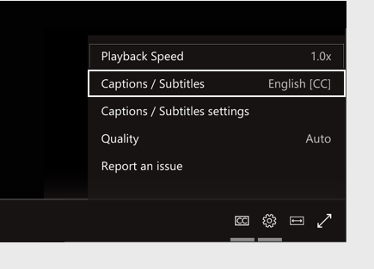
Welcome!
Today’s live meeting includes closed captions available in Chinese (Simplified), English, Korean, Russian, Spanish, Ukrainian and Vietnamese
To turn on live captions and subtitles, select the Captions/Subtitles On button in your video controls.
To change the caption language, select the Settings gear icon, then select Captions/Subtitles Settings, and choose the language you want.

Slide 2
Materials
Slides are available on Section 1332 website
  Direct link: Public forum for Washington’s Section 1332 State Innovation waiver | Washington Health Benefit Exchange
  This meeting is being recorded
  Recording will be available on Section 1332 website (link above) for the duration of the public comment period.

Slide 3
Your participation
Please feel free to introduce yourself by putting your name and organization in the Q&A box!
Purpose of today’s public forum is to accept public comments on the progress of Washington’s Section 1332 State Innovation Waiver. Comments will be summarized and included in an upcoming federal report.
  How to submit a virtual public comment:
    Write “public comment” in the Q&A box followed by your comment.
  How to submit a written public comment:
    Send an email to WA1332@wahbexchange.org with, “Annual public forum comment,” in the subject line.
Notes:
How to submit a question
Questions about the content being presented can be entered into the Q&A box throughout the webinar.

Slide 4
Immigrant health coverage
Annual public forum
Washington Health Benefit Exchange Update
May 22, 2025

Slide 5
Today’s presenter
Joan Altman, She/Her
Director of Government Affairs
& Strategic Partnerships
Washington Health Benefit Exchange joan.altman@wahbexchange.org
Supporting Exchange staff
Lisa Jonson, She/Her
Immigrant Health
Coverage Coordinator
lisa.jonson@wahbexchange.org

Slide 6
Today’s topics
I. Waiver background and overview
II. Second year highlights
III. Second year outcomes
IV. Public comment

Slide 7
I. Waiver background and overview

Slide 8
Background on Section 1332 waivers
States can pursue innovative strategies to provide access to high-quality, affordable health insurance by changing or waiving parts of the Affordable Care Act (ACA).
Section 1332 waivers are approved in five-year increments, and the state must annually submit reporting to request pass-through and affirm state adherence to federal restrictions (guardrails).
Under the waiver, the Exchange is also required to host an annual POST-AWARD FORUM to accept public comment on the progress of the Section 1332 waiver.

Slide 9
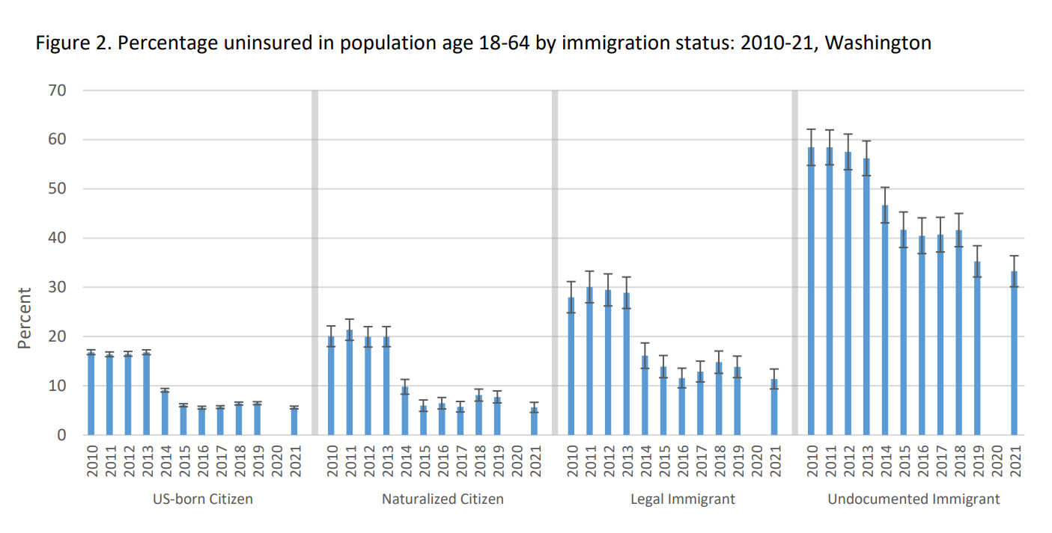
Who is uninsured in Washington?
Being an undocumented immigrant is the strongest predictor of being uninsured.
Data Source: Office of Financial Management Research Brief No. 112 (August 2023) : Washington’s non-citizen immigrant population continued to experience disparities in health coverage
Notes:
About 100k uninsured, undocumented folks; ~27% of uninsured pop in WA (372k) - ties to Jan 2025 uninsured report.
Data source: American Community Survey 2023 1-year PUMS with OFM adjustment for Medicaid enrollment.

Slide 10


Qualified Health and Dental Plan Expansion
Washington applied for its first 1332 Waiver on May 13, 2022. It was approved Dec. 9, 2022, for a five-year period — 2024 through 2028.
The first-in-kind waiver allows all Washington residents, regardless of immigration status, to purchase health and dental coverage through Washington Healthplanfinder.
The section of the ACA preventing people who are undocumented from accessing federal premium tax credits and cost sharing reductions could not be waived.
Additional privacy protections were negotiated.

Slide 11
Privacy considerations
Privacy considerations were top-of-mind when the 1332 Waiver was being developed and submitted
  2020 WAISN health access survey, and community listening sessions conducted by Health Equity for Immigrants Campaign, found that: “distrust of healthcare system and sharing information with government, including on health coverage applications, is a barrier to accessing care.”
  State and federal public comments received during 2022 waiver submittal process echoed these concerns.
  Listening sessions and landscape scans conducted by the Exchange and community-based implementation partners in 2023 also noted mistrust of government and the need for trusted community partners to help address continued concerns.
Strengthening privacy protections were a key part of state negotiations with CMS and Treasury/
IRS during the 1332 waiver approval process
  Strong, first-in-kind, privacy language in federal 1332 approval/contractual documents.
  Updated federal (CMS and IRS) reporting requirements to exclude identifying information for newly eligible population.
In addition to negotiated federal safeguards, the Exchange took steps to further protect data
  Exchange Immigrant Health Coverage Data Policy.
  End-to-end review of all system integrations with federal partners and insurance carriers to enhance privacy.
  Updated identity proofing policy and procedures.

Slide 12
Washington’s Section 1332 Waiver Overview
  Enables all Washingtonians to shop for health insurance through Washington Healthplanfinder.
  Enables all Washingtonians, regardless of immigration status, to get health and dental insurance through Washington Healthplanfinder, including higher value standard and public option plans.
  Enables all Washingtonians to benefit from the state premium subsidies.
  Allows families with members with different immigration statuses to purchase health insurance together.
  Maximizes existing processes and procedures that keep consumer data private and secure.
  Strengthens Washington’s health care sector, to the benefit of all current customers.
Notes:
Also - tried for pass through funds to enable the state to benefit from any federal savings generated (which would further support state subsidies). Pass through funds not approved – so receive no federal funding in support of the waiver.

Slide 13
Washington’s Section 1332 waiver overview
All Washingtonians can shop for private health insurance on Washington Healthplanfinder
  Regardless of immigration status and income level, can purchase qualified health and dental plans
Can access standard and public option plans
  Higher quality benefits with lower premiums
Can receive state premium subsidies if income is up to 250% FPL
  Due to federal restrictions, newly eligible cannot receive federal subsidies

Slide 14
II. Second year highlights

Slide 15

Continued community outreach and engagement
In year two, the Exchange continued to engage affected community members and local organizations to inform outreach efforts.
Top reported access barriers continue to be:
  Affordability
  Mistrust of government/government websites
  Health literacy and language access.
Notes:
Listening sessions – July – Oct 2022
Landscape scans – Oct 2022 – March 2023
Educational and Outreach campaign – March 2023 – present.
Have continued Multicultural/Multilingual Media Campaign/VIDA partnership.

Slide 16
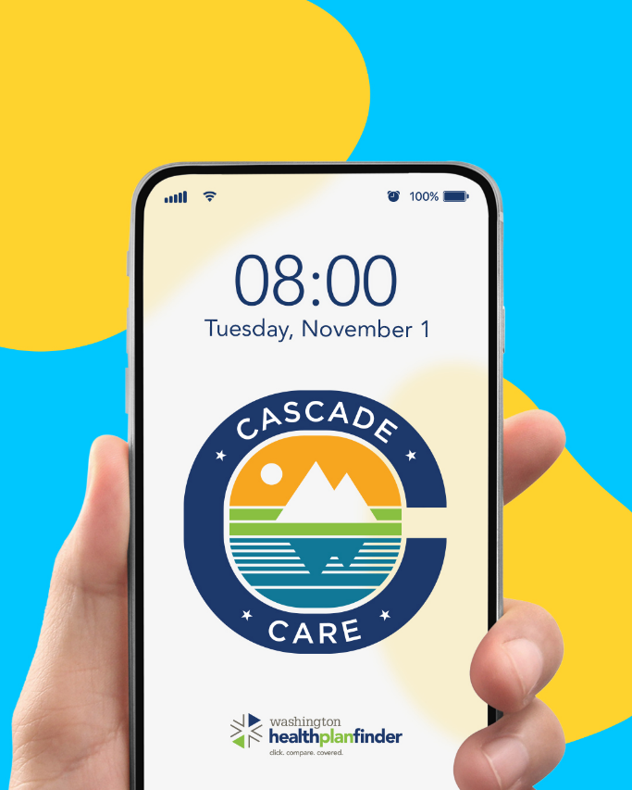
State subsidies support more affordable access
State legislature has made state premium subsidies available for all eligible qualified health plan customers up to 250% FPL
  ~82% of waiver customers are receiving state premium subsidies; affordability challenges remain.
  Average monthly net premium (after state premiums applied) is $342.

Slide 17
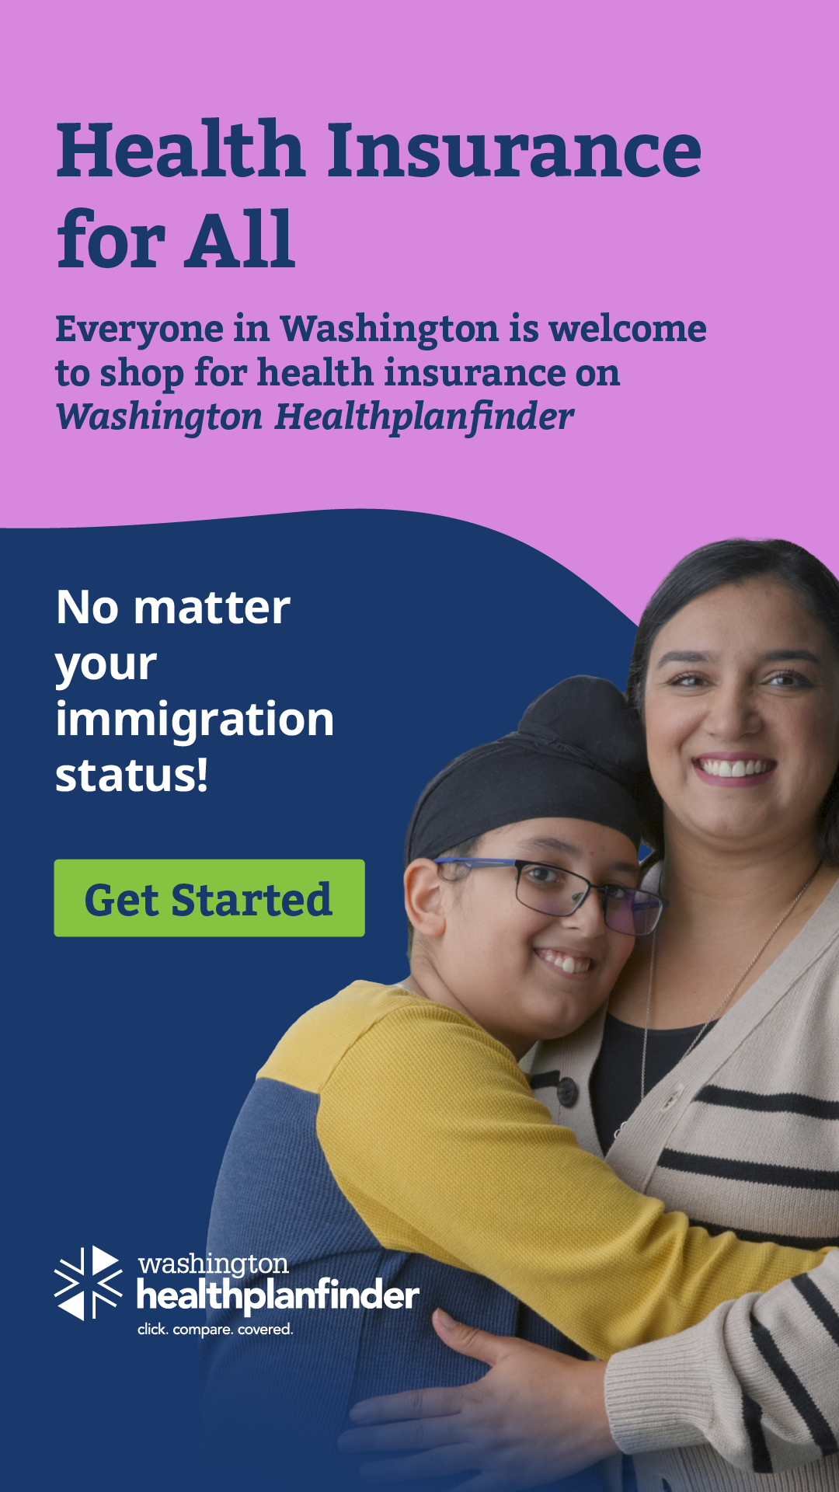
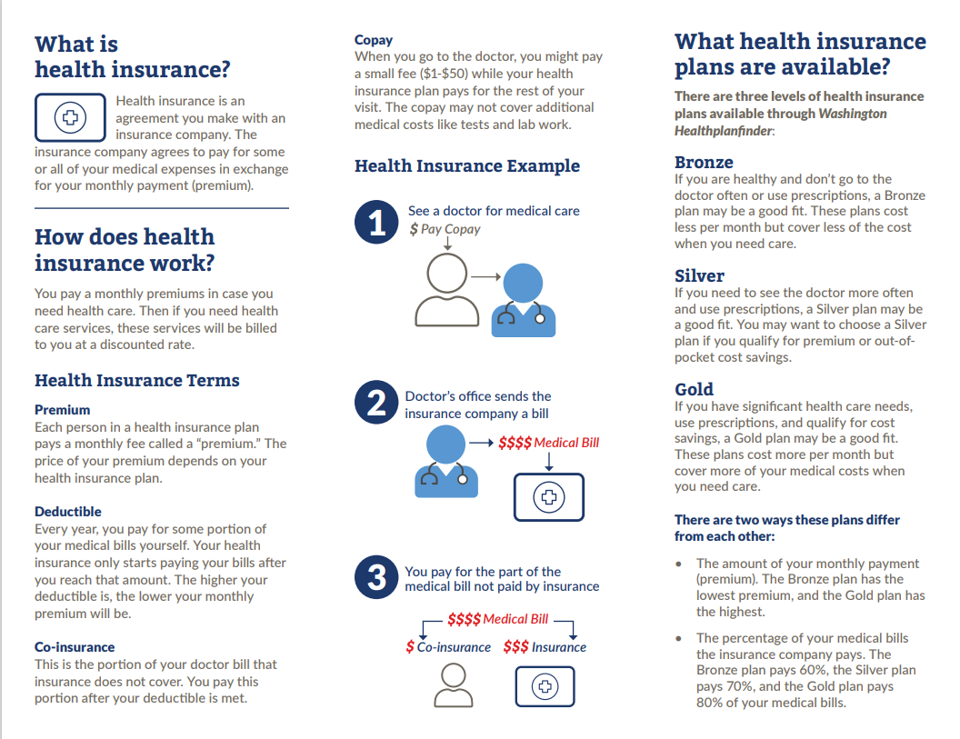
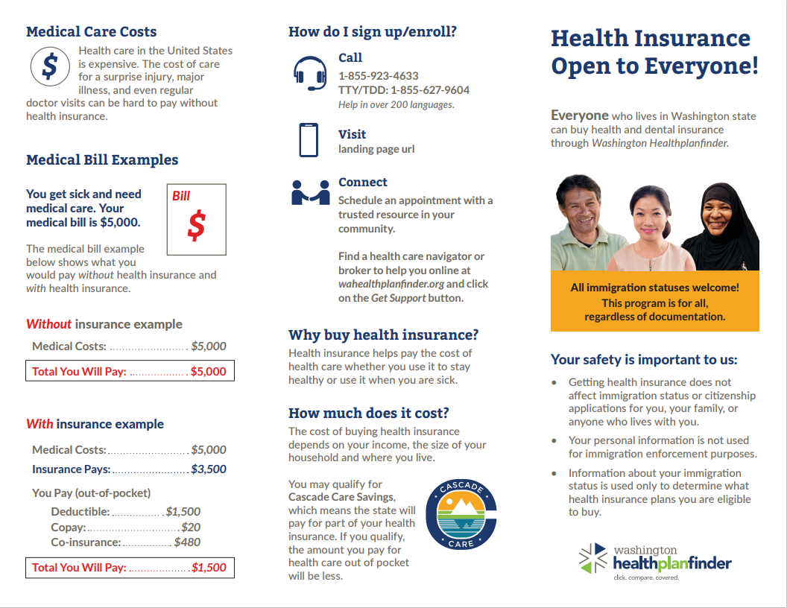
Health literacy and language access
The Exchange has been partnering with The Vida Agency, a women and minority-owned multicultural marketing firm to support education and outreach conducted by enrollment partners, community-based organizations, and other customer serving team members (call centers, etc.).
Materials emphasize education
Created information in multiple languages, mediums/formats (videos, print, digital, artwork)

Slide 18
Trusted community-based partners
The Exchange partners with a robust network of trained community-based assisters who help customers select and enroll in health and dental plans through Washington Healthplanfinder.
  2,000+ certified producers
  1,000+ Navigators
  100 Tribal Assisters
  9 Enrollment Centers
The Exchange provides funding directly to community-based organizations (CBOs) to assist with outreach.
Central Washington Justice for Our Neighbors
Comunicativo
Ensemble of Washington
Entre Hermanos
Korean Community Service Center
Muslim Community Network Association
Oasis
Seattle Chinese New Immigrants Center
South Puget South Pathways
Unidos Nueva Alianza Foundation
United Territories of Pacific Islanders Alliance (UTOPIA)
Washington Immigrant Solidarity Network (WAISN)
Washington West African Center
Notes:
13 total CBOs – held events, helped develop materials
Washington West African Center
Held an Insurance Application & Vaccination Clinic on Dec 21^{s--}Event video invite: OUTREACH FOR THE WAWAC INSURANCE APPLICATION AND VACCINATION EVENT ENGLISH – YouTube
2) Created Open Enrollment Videos (in English, French + several African languages): English, French, Fantee, Wollof, Mandinka and Fula
3) Taped a “skit” relaying the importance of health insurance to community members – CBO leaders felt this was a powerful and culturally appropriate way of relaying info
Oasis
HPF + Health Insurance Literacy Videos in Indigenous Latin American Languages: Awakateco, Mam, Mixteco (from Guerreo & Oaxaca, Mexico)
Ensemble
Created short videos on Washington Healthplanfinder and open enrollment in Yoruba, Amharic, Lingala, Tigrinya, Arabic, French, Swahili, and Spanish.
WAISN
DACA Video: https://m.youtube.com/shorts/hujW-qCoIXM

Slide 19
III. Second year outcomes

Slide 20
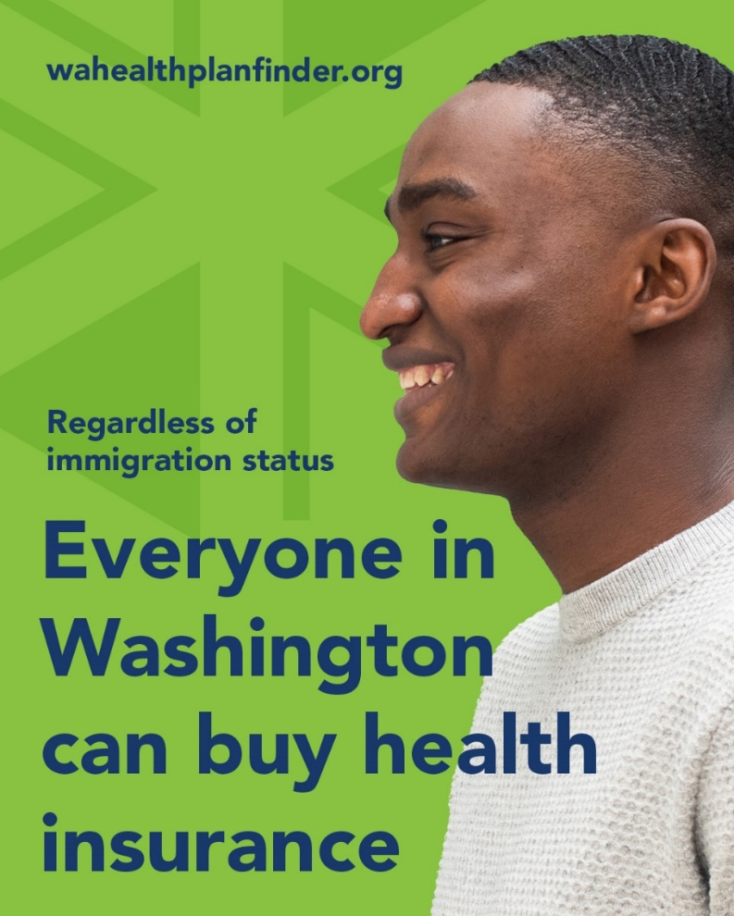
Second year top lines– Enrollment
~15k applied for health coverage under the 1332 Waiver since Nov. 1, 2024 (start of open enrollment for 2025).
~2,400 signed-up for health coverage.
  Including 1,200 new customers.

Slide 21
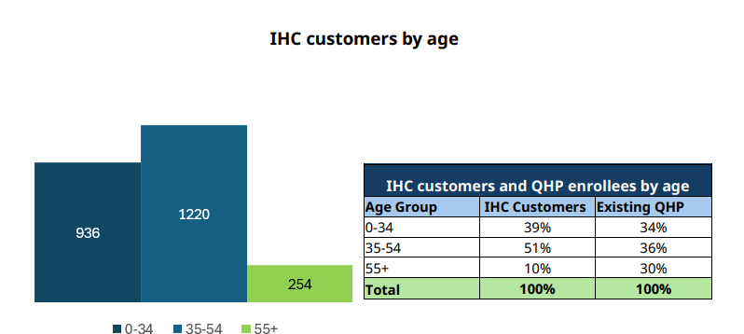
Second year top lines – Age
Waiver (IHC) customers are significantly younger than overall Exchange customers
  90% are under the age of 55, compared to 70% of the over QHP population.

Slide 22
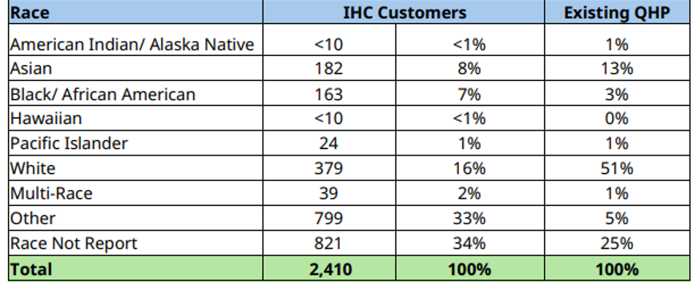
Second year top lines – Race and ethnicity
Waiver customers are more diverse than the overall Exchange customers
  Among customer who identified race, 84% of the waiver population identified as non-white, compared to 49% of overall QHP customers.
  Among customer who reported ethnicity,61% of the waiver population identified as Hispanic, compared to 9% of overall QHP customers

Slide 23
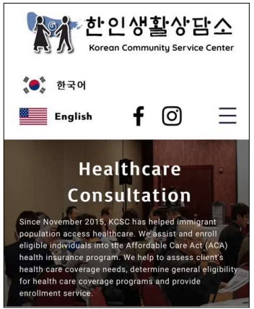

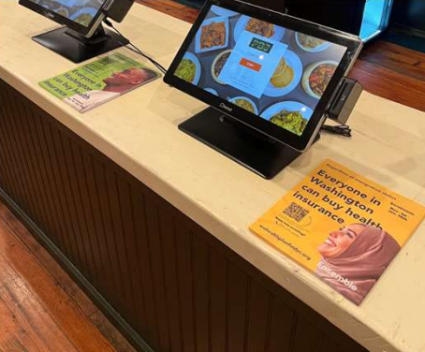





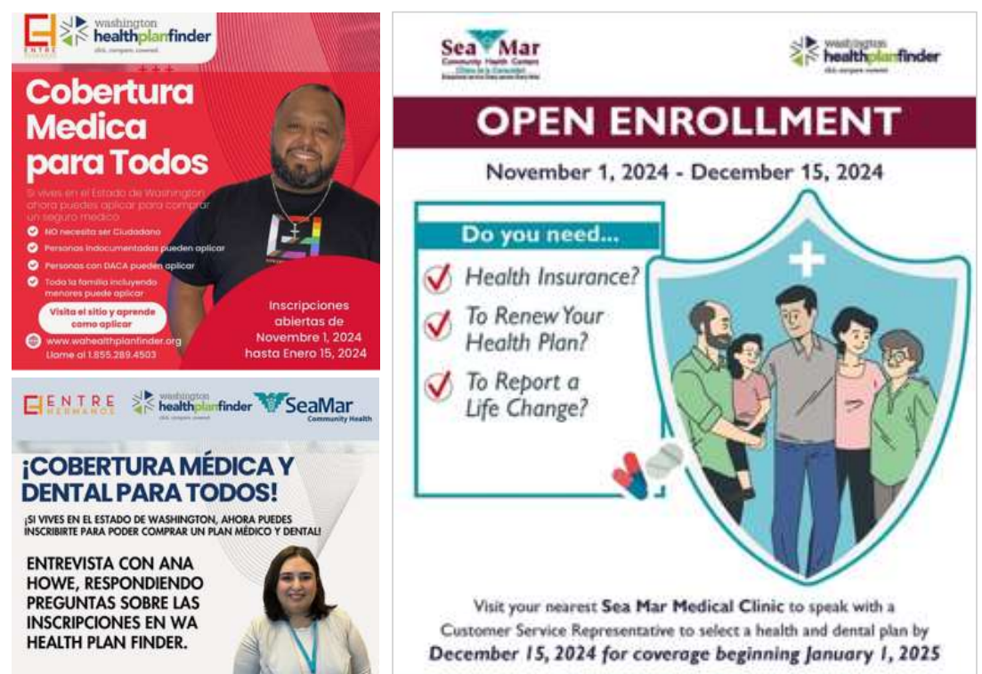
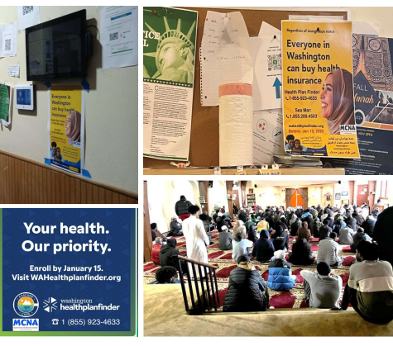
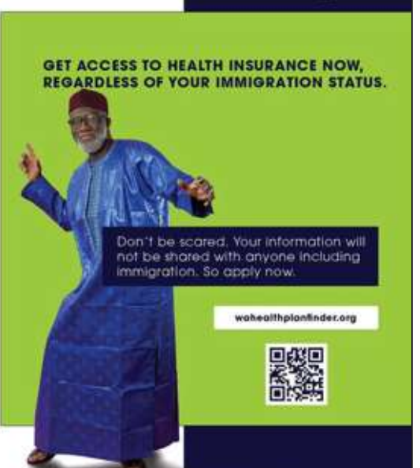

75% of waiver customers had a trained assister help them enroll

Slide 24
Current activities
Continuing to monitor PY 2025 enrollments
Submitting federally required reports
Monitoring federal activity related to 1332 waivers
Preparing for the upcoming open enrollment (OE) period

Slide 25
IV. Public comment

Slide 26
Public comment
Purpose of today’s public forum is to accept public comments on
the progress of Washington’s Section 1332 State Innovation Waiver.
How to submit optional public comment
  Virtually:
    Write “public comment” in the Q&A box followed by your comment.
  Over email:
    Send an email with your comment to WA1332@wahbexchange.org with “Annual public forum comment” in the subject line.

