Slide 1

DEI Manager
Jasper Marino
(They/Them pronouns)

Slide 2

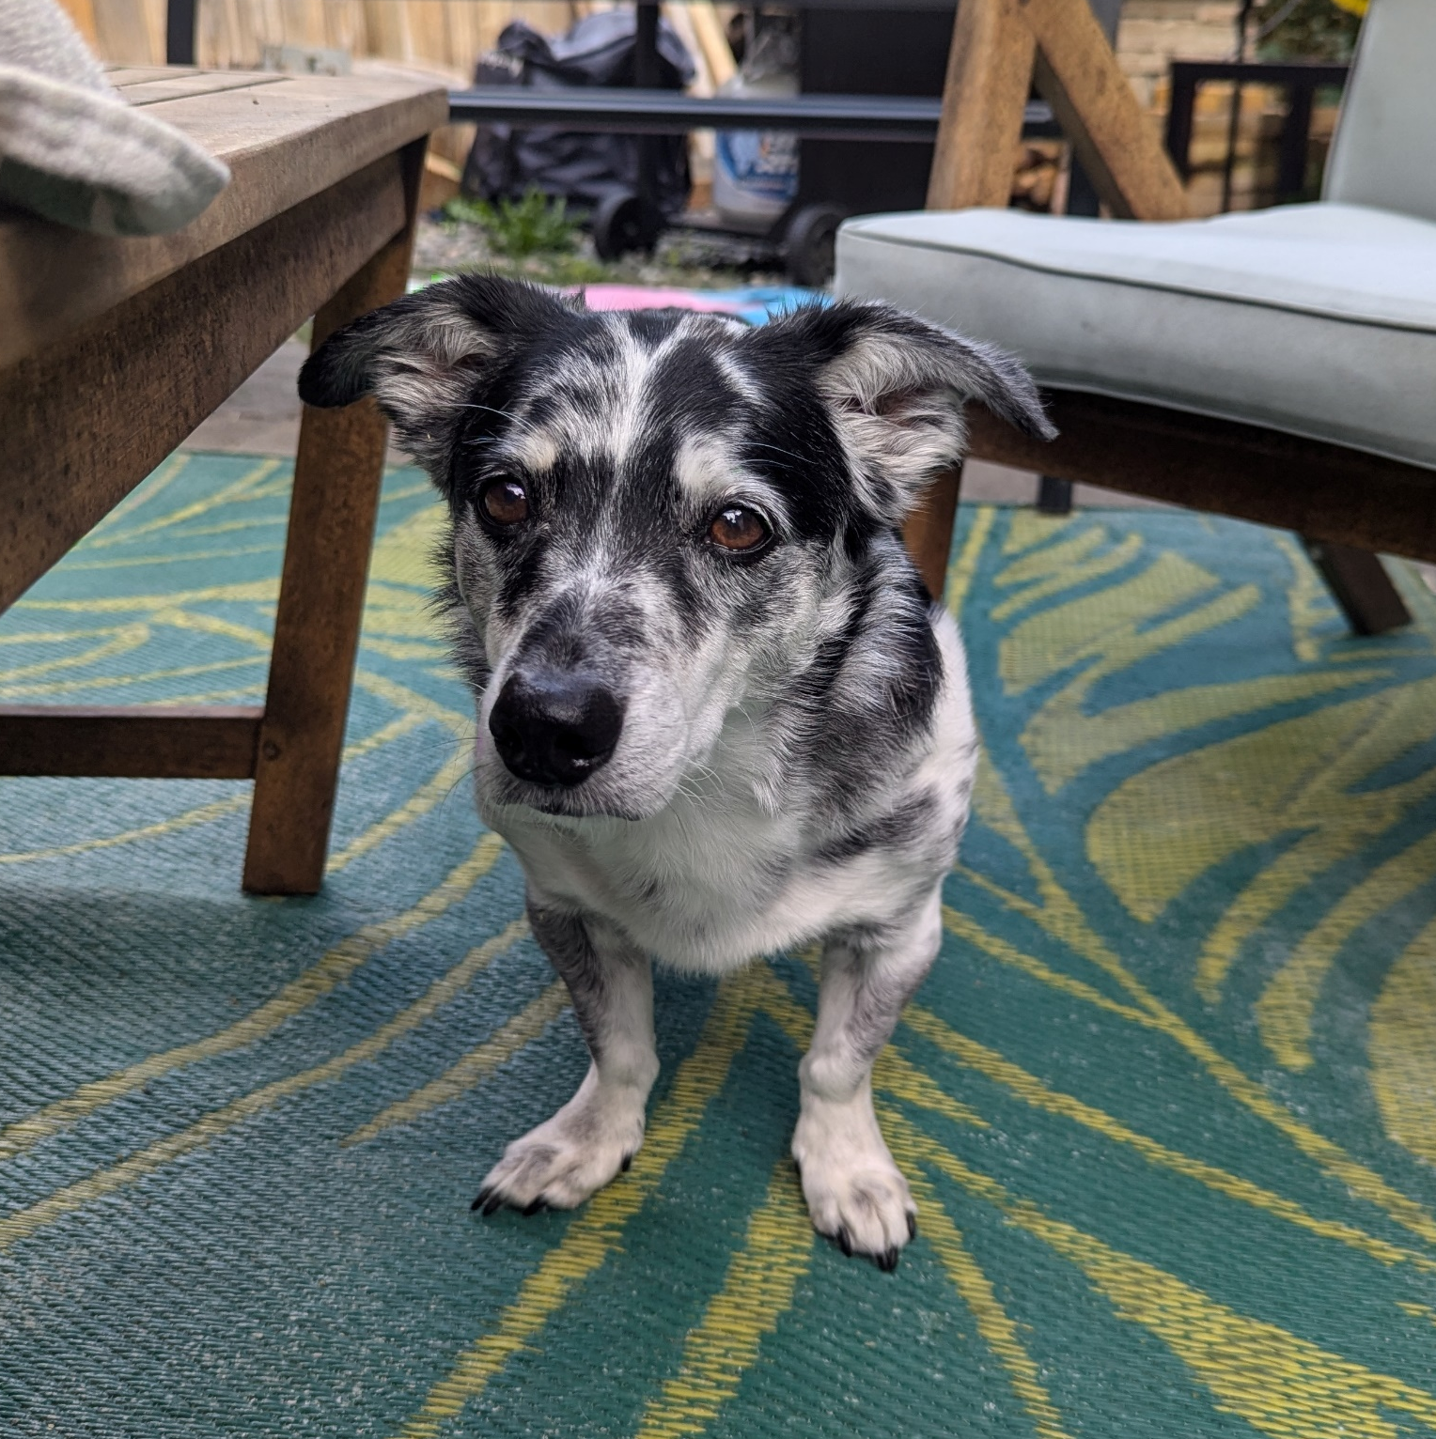
A little about me…
me
Personal:
Grew up in Connecticut
Currently live in Olympia with my partner Miro and dog Steve
Transgender, queer, and nonbinary
Professional:
Started with WAHBE in June this year
Previously was at Employment Security Department (ESD) as the Equity, Diversity, and Inclusion Employee Experience Manager
Prior to that I was an Equal Opportunity Consultant in ESD’s Equal Opportunity Office
Most of my earlier career was focused on community advocacy
Steve

Slide 3

Exchange Equity Statement
Equity is fundamental to the mission of the Washington Health Benefit Exchange. The process of advancing toward equity and becoming anti-racist is disruptive and demands vigilance to dismantle deeply entrenched systems of privilege and oppression. While systemic racism is a root cause of many societal inequities, we must also use an intersectional approach to address all forms of bias and oppression, which interact with and often exacerbate racial inequities. To be successful, we must recognize the socioeconomic drivers of health and focus on people and places where needs are greatest. As we listen to community, we must hold ourselves accountable to responding to recommendations to remedy inequitable policies, systems, or practices within the Exchange’s area of influence. Our goal is that all Washingtonians have full and equal access to opportunities, power and resources to achieve their full potential.

Slide 4

My role…
DEI Manager
The goal of this position is to strengthen the organization’s overall equity maturity, foster inclusion and belonging for a diverse workforce, and provide the foundation to advance equity through all operations and services.
Most of my work will be in collaboration with other people.

Slide 5

Three buckets of work…
Internal Culture
External Impact
Systems

Slide 6

Workforce diversity, inclusion, and belonging
Assess organizational equity and identify opportunities for growth.
Learning opportunities for staff .
Employee Resource Groups.
Exchange DEI Committee.
Make recommendations regarding strategies to improve workplace diversity, inclusion, and belonging.
Internal Culture

Slide 7

Equitable policy development and program implementation
Policies, programs, best practices and procedures that drive equity.
Create equity impact assessment tools
Cross-functional teams leading major programmatic initiatives
Health equity data and health disparity reduction.
Support the Exchange in continuous learning and innovation.
Systems

Slide 8

Community engagement and customer experience
Lead navigator organizations; relationships with tribal communities, brokers, assistors and CBOs.
Customer journey mapping
UI/UX HealthPlan Finder platform experience
Review and inform training materials for our Customer Support Center representatives.
Effective communication with Exchange customers.
External Impact

Slide 9


Areas of interests….
Equity and Belonging plan
Creating an equity impact assessment
Equity in all policies review
Data analysis for disparities
Customer journey mapping
UX /UI equity support
SOGI implementation
And more….
Notes:
These are areas I am focusing on right now that may be of interest to this group.
Equity and Belonging plan- This will focus on my entire roll and outline the work I will do.
Creating an equity impact assessment- This will be a tool that can be used to assess impact when looking at policies and processes.
Equity in all policies review- this will include our external facing policies that impact our customers and partners
Data analysis for disparities- I am still learning about the data we collect, taking a look at are we collected the right data for what we use it for, how are we utilizing the data, and identify any gaps.
Customer journey mapping
UX /UI equity support
SOGI implementation

Slide 10




Questions?
Jasper.marino@wahbexchange.org
360-688-1569
Notes:
Give a few examples of what we can talk about:
DEI topics you are curious about,
Equity impacts of a project or work you are doing,
DEI resources,
Barriers that you have observed,
Culture support on your team
Etc.

