Slide 1
Customer Service for the Future
Washington Health Benefit’s Journey to Provide More Inclusive, Consistent, Human-Centered Customer Service

Slide 2
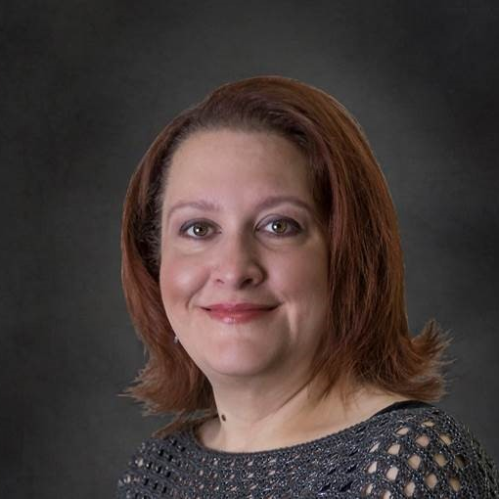
Presenter
DATE: October 9, 2024
Carla Reyes (She/Her)
carla.reyes@wahbexchange.org
360-688-7781
Chief Operating Officer

Slide 3
Customer Service Continuum
Healthplanfinder
Customer Support Center
Certified Assister Network
Eligibility
Enrollment
Appeals
Self-Service
Person-centered Assistance
Complexity of Support

Slide 4
Customer Service Continuum
Healthplanfinder
Customer Support Center
Certified Assister Network
Eligibility
Enrollment
Appeals
What is the consistent customer experience?
Self-Service
Person-Centered Assistance
Complexity of Support

Slide 5
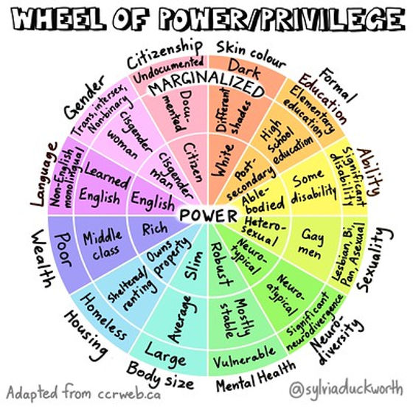
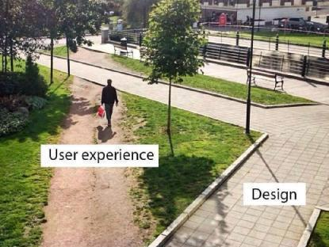

Apply Human Centered Design & an Equity Lens
Be more culturally humble, inclusive and avoid bias
Build trust through transparency and authenticity
Enhance usability and accessibility
Improve satisfaction

Slide 6
Get Curious
Customer
How do they interact with different points of connection?
How do they describe their experience?
What outcomes are important to them?
What would they think, feel or believe after their interaction?
What quality of information do they receive?
How do they get information?
Listen, learn and ask!
What is the current experience?
What is the desired future experience?
30%

Slide 7


Collaborate to Build a Better Customer Experience

