Slide 1
Senate Health Care Work Session
Pam MacEwan, CEO

Slide 2
Overview of 2020 Exchange Health Plans
  9 carriers approved to offer QHPs for 2020
    Two new carriers: PacificSource and Providence
  66 approved QHPs (up from 40 in 2019)
  8 counties with one issuer for 2020 (down from 14 in 2019)
    Single-issuer counties all served by LifeWise/Premera
  All carriers now offering a bronze plan
  Average rate decreases – rates stabilized, but still expensive
    Returning Exchange customers experienced an average premium decrease of $19/month; Deductibles increased
    As a result of the new lower-cost plan options some consumers experienced a lower federal premium tax credit, shopped to take advantage of the lower price options
Notes:
Many carriers submitted rate decreases
More plan options for consumers
Lower priced plans available in most counties for 2020
Rate changes range from a decrease of ~9% for Molina to an increase of ~5% for Kaiser NW.
Rate changes range from a decrease of 9.29% for Molina to an increase of 5.20% for Kaiser NW*
Final average rate decrease of -3.5% compared to proposed average rate decrease of -1%*
Final rates for Coordinated Care, Molina, Kaiser WA, and Kaiser NW are lower than proposed

Slide 3
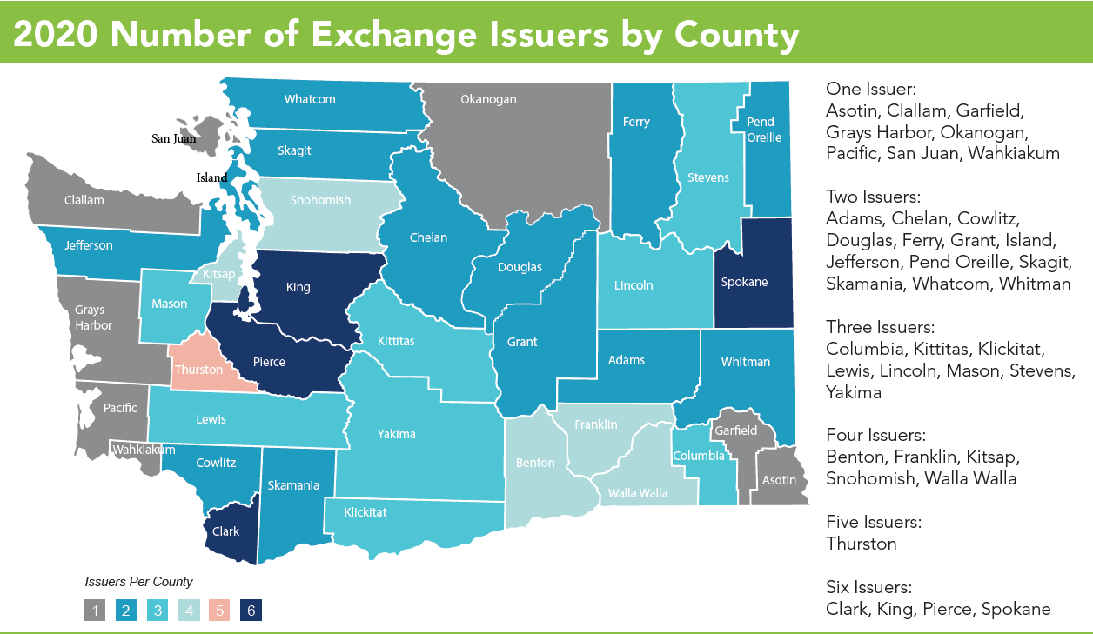
Notes:
Handout with comparison to last year

Slide 4
Healthplanfinder Enhancements
  New Plan Preview
    Customers could view available plans before open-enrollment
  New chat function on Healthplanfinder
  Extended Healthplanfinder system hours (up 24/7)
  Continued improvement of consumer decision support tool (Smart Planfinder)
  Mobile app (nearly 180k downloads)
    Over 18k applications submitted from app (38% increase from last year)
    48% more documents submitted through app (take photo which immediately uploads to customer’s account)
  New in-person Enrollment Center in Everett (bringing total to 11)
Notes:
At the end of 2018, we had 24,670 documents uploaded through the app. At the end of 2019, that number was 36,645.
Users visiting wahealthplanfinder.org are nearly an even split between using a desktop machine (53%) and mobile/tablet (46%) in 2019.

Slide 5
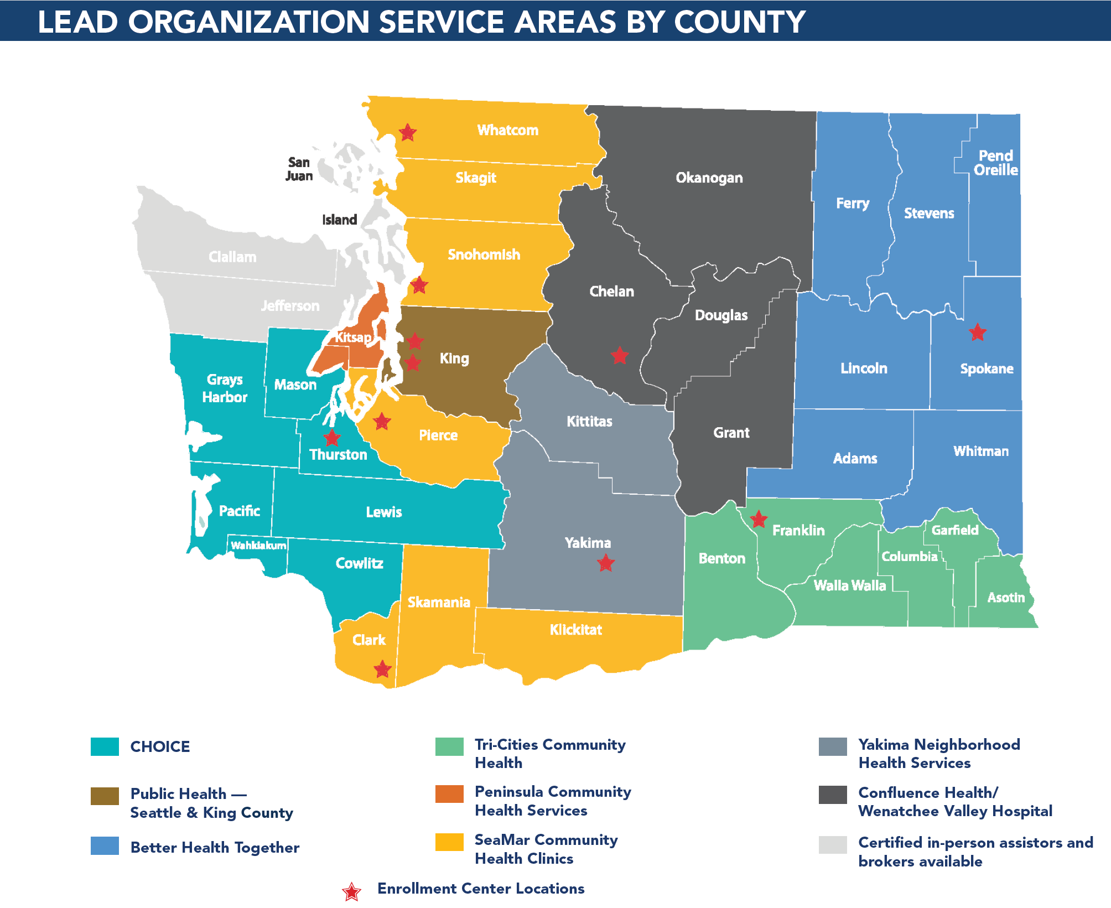
Notes:
The Exchange has a robust network of customer support across Washington State to help customers enroll in coverage that meets their needs and budget, which includes:
1600 certified Brokers
800 certified Navigators
100 certified Community Assisters
100 certified Tribal Assisters
11 Exchange Enrollment Centers
Korean Women’s Association – reaches a very vulnerable population and assists immigrants by enrolling in a variety of programs, including healthcare
Multi-lingual navigator services in Korean, Vietnamese, Cambodian, Russian and Mandarin Chinese

Slide 6
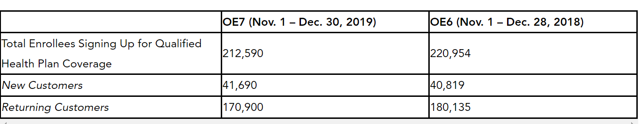
Open-Enrollment Activity
Over 212,000 signed up during open enrollment
60% subsidized; 40% non-subsidized
41,000 new (slight increase from last year)
  Less new younger customers (18-34)
Overall, 3.8% decrease in sign ups from last year
Notes:
18-34 y/os decreased from 38%-36%

Slide 7
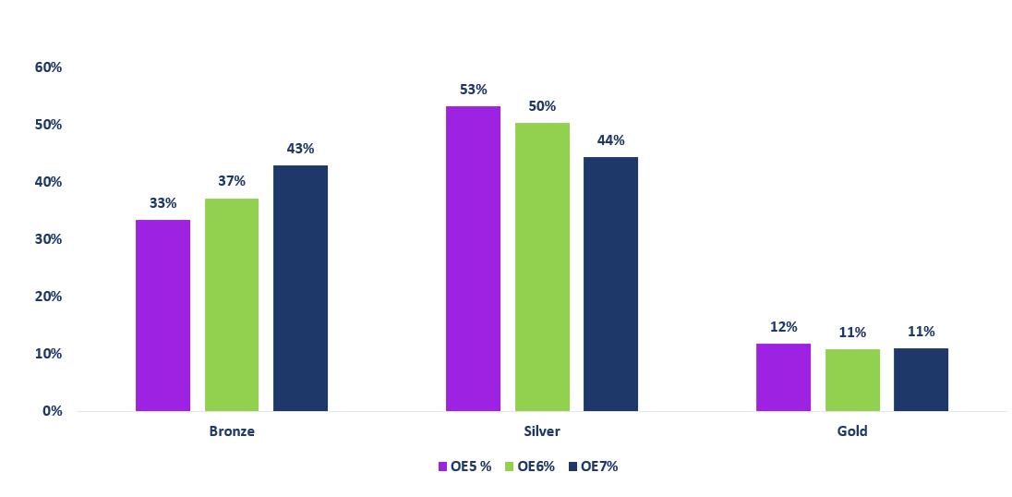
Ongoing Affordability Concerns
More customers choosing bronze
  Half of new enrollees chose bronze
More returning customers shopped/switched
  Majority moved to a lower priced option
Dropping among both non-subsidized and subsidized
  Surveying customers who dropped to get more information
Notes:
Of drops—more subsidized 52%→55%; nonsub 48%→45%
70% of consumers who switched carriers, switched to Lifewise or Molina
64% of renewals who changed their plan received a premium decrease

Slide 8
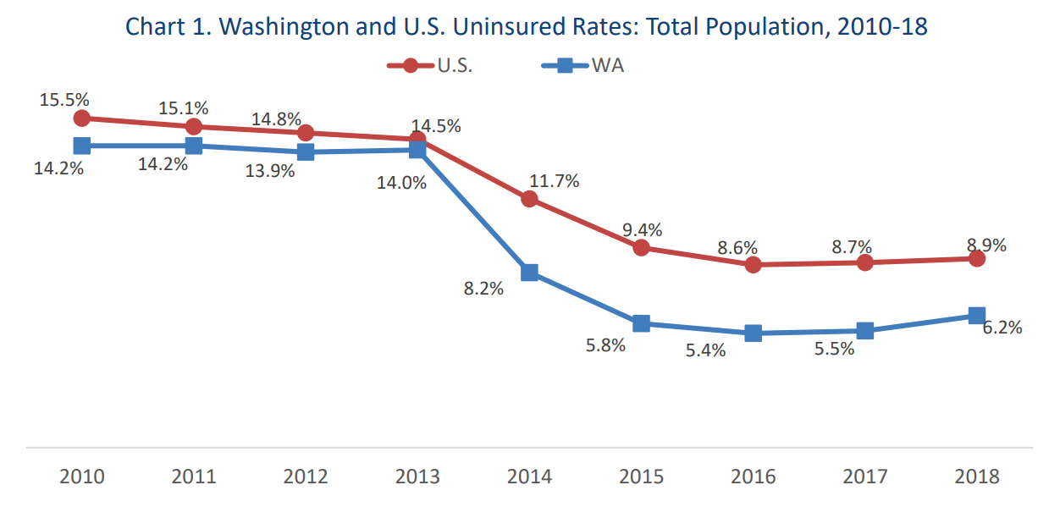
Uninsured Rate Increasing
Office of Financial Management, Research Brief No. 95 (Dec. 2019)

Slide 9
Cascade Care (SB 5526) Overview
Response to rising premiums and deductibles and declining enrollment in the individual market and failure to enact reinsurance
3 Main Parts:
  Standard Plans: Goal to make care more accessible by lowering deductibles, making cost-sharing more transparent, and providing more services before the deductible
  Public Option Plans: Goal to make more affordable (lower premium) options available across the state, that also include additional quality and value requirements
  Subsidy Study: Goal to develop and submit a plan for implementing premium subsidies through Exchange for individuals up to 500% FPL (report due Nov. 15, 2020)

Slide 10
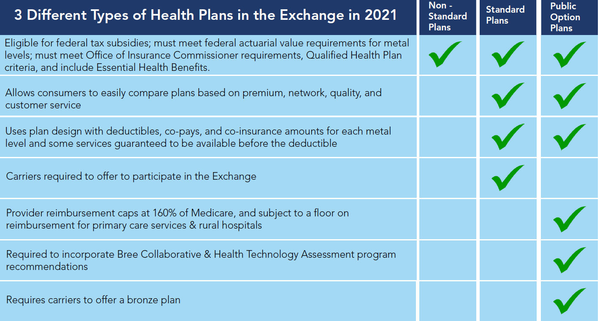

Slide 11
Upcoming Activity
Develop Cascade Care outreach and education materials
Design and implementation of system updates to support Cascade Care implementation
Continued support HCA’s upcoming procurement
Begin work on mandated subsidy study
Continued focus on affordability and market stability
Notes:
Reinsurance:
State reinsurance program proposed in 2018 session
No agreement on financing source
Mandate:
State mandate proposed in 2018 and 2019 session
WA state does not have an income tax (implementation challenge)
Continued work leading up to the 2020 session

Slide 12


Questions?
Pam MacEwan
CEO, Washington Health Benefit Exchange
pam.macewan@wahbexchange.org
http://wahbexchange.org

Slide 13
Appendix

Slide 14
2020 Legislative Priorities
Supplemental Budget
The Exchange has submitted its annual Cost Allocation Update, a maintenance level, net-zero adjustment to reflect the updated federal Advanced Planning Document. No new General Fund – State dollars are being requested
Delivering on 2019 Legislative Priorities
The Exchange’s emphasis in 2020 is on delivering on commitments from last session, including COFA Dental and Cascade Care (SB 5526)
Leveraging Washington Healthplanfinder Platform
The Exchange is actively engaged in the HHS IT Coalition (DCYF, DOH, DSHS, HBE, HCA), which is exploring longer-term, collaborative opportunities to improve the customer/client application and eligibility experience.

Slide 15
Standard Plan Development Process
Ongoing close collaboration between Exchange, HCA, and OIC
Exchange convened a workgroup including carriers, consumer advocates, providers, and business and labor representatives to inform plan design process
Exchange consulted with carriers to solicit technical feedback
Exchange contracted with Wakely Consulting to conduct actuarial analysis of plan designs
Public comment period on standard plans was held from Oct. 18 – Nov. 18
Standard plan designs unanimously approved by Exchange Board on Dec. 5
Open and transparent process – all materials available at: https://www.wahbexchange.org/about-the-exchange/cascade-care-2021-implementation/

Slide 16
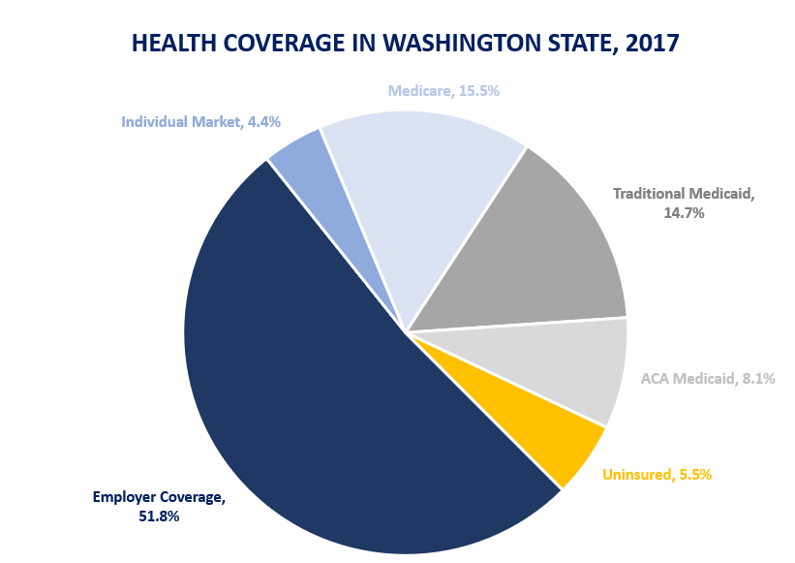
Individual Market Covers 4% of Washingtonians
Office of Financial Management
Forecasting & Research Division
Notes:
Health ministries and AP a factor, but not yet significant

Slide 17
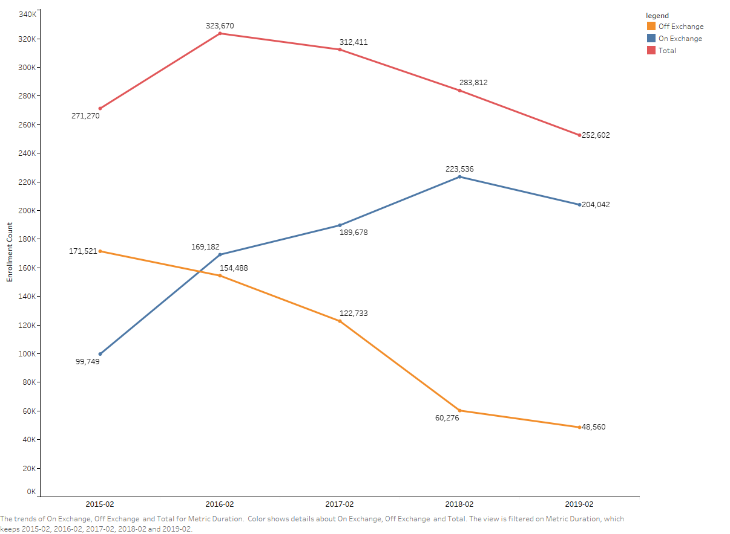
80% of Individual Market Obtains
Coverage Through Washington Healthplanfinder
Office of Insurance Commissioner: February WA Individual Market Enrollment
Notes:
Approximately 248,000 people who don’t get coverage from their employer must buy their own health insurance through the individual market, with most shopping on the Exchange.

Slide 18
2020 Exchange QHPs - Metal Level Overview
9 QHP Issuers | 66 QHPs
Gold
76%-82% AV
15 Plans
Silver
66%-72% AV
CSRs available
21 Plans
Bronze
56%-65% AV
26 Plans
Catastrophic
Only through the Exchange
Under age 30 or hardship
No tax credits
4 Plans
9 Issuers
9 Issuers
9 Issuers
4 Issuers

Slide 19
Deductibles for 2020
 | 2019 |  |  | 2020
GOLD
Deductible Range |  | $0 - $2,925 | $0 - $2,925
Median Deductible |  | $1,175 | $1,200
SILVER
Deductible Range |  | $2,000 - $7,150 | $2,000 - $7,500
Median Deductible |  | $4,500 | $4,750
BRONZE
Deductible Range |  | $4,750 - $6,500 | $5,000 - $7,000
Median Deductible |  | $5,600 | $6,350
Deductibles shown are for an individual.
Silver deductibles presented in this graph are for a standard silver plan (no cost sharing reductions).

Slide 20
Outreach Targets & Locations
During Open-Enrollment
COFA Islanders
Sikh community
Black-African community
American Indian/Alaska Native
Latinx community
LGBTQ+ Community
Self-employed residents
Zip codes with high uninsured rates
Rural residents
Low-income families
Young adults
College students
Libraries
Coffee shops
Cultural Community Centers
Religious Institutions
Sporting events
Regional Fairs
Farmers markets
Worksource locations
Health Fairs
School events
College campuses
Community Clinics
DSHS Offices
Local health district offices
Technical skills training centers
Notes:
Outreach highlights:
Outreach in King Co to rideshare drivers (Uber/Lyft)
Frequent locations where drivers congregate
Many drivers come back year after year
Mobile medical vans in King Co and Yakima set up to conduct a full medical evaluations
Can be used at school events for sports physicals, rural locations, etc
Yakima has behavioral health specialists trained as navigators
In the community equipped with tablets, hotspots and backpacks to help a variety of individuals with whom they come into contact
COFA population – Better Health Together hired and trained a COFA community member as a navigator last OE; they are working to hire an interpreter this year to assist their navigators
Creative uses of data:
For example, King Co saw there was a zip code in north Seattle with a high uninsured rate. After talking with the local neighborhood business chamber, they realized it was because there are many freelancers in the area who have a higher income but never got around to getting insurance. So King Co set up enrollment events at key coffee shops where these folks congregate and were able to see success in enrolling them.

Slide 21








Understanding Our Customers
Usability Testing
Surveys
Consumers test upcoming system changes before they are implemented.
The Exchange solicits feedback from customers and assisters through surveys of:
All Customers
New Customers
Customers Who Did Not Renew
Customers with Limited English Proficiency
Navigators
Brokers
Expert Review
Focus Groups
Exchange staff enlist design experts to: review system designs for clarity and ease of use; share existing best practices; and provide design recommendations.
The Exchange tests messaging with groups of residents including:
Existing customers
Outside market customers
Uninsured residents
Other
Social Media
Web & Mobile Analytics
Marketing & Outreach Events
Notes:
Surveys following OE each year
Consumer Experience (Jan 2018)
Open Enrollment Experience – Navigators (Jan 2018) & Brokers (Feb 2018)
Renewal experience (Feb 2018)
New Experience (May 2018)

Slide 22
